Slide 1
PROJECT
MANAGEMENT
PLAN

Slide 2

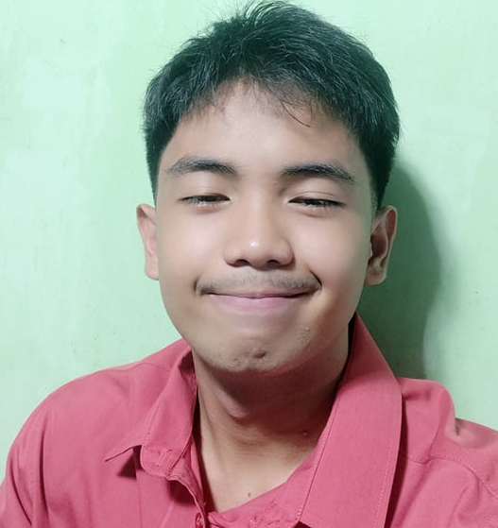
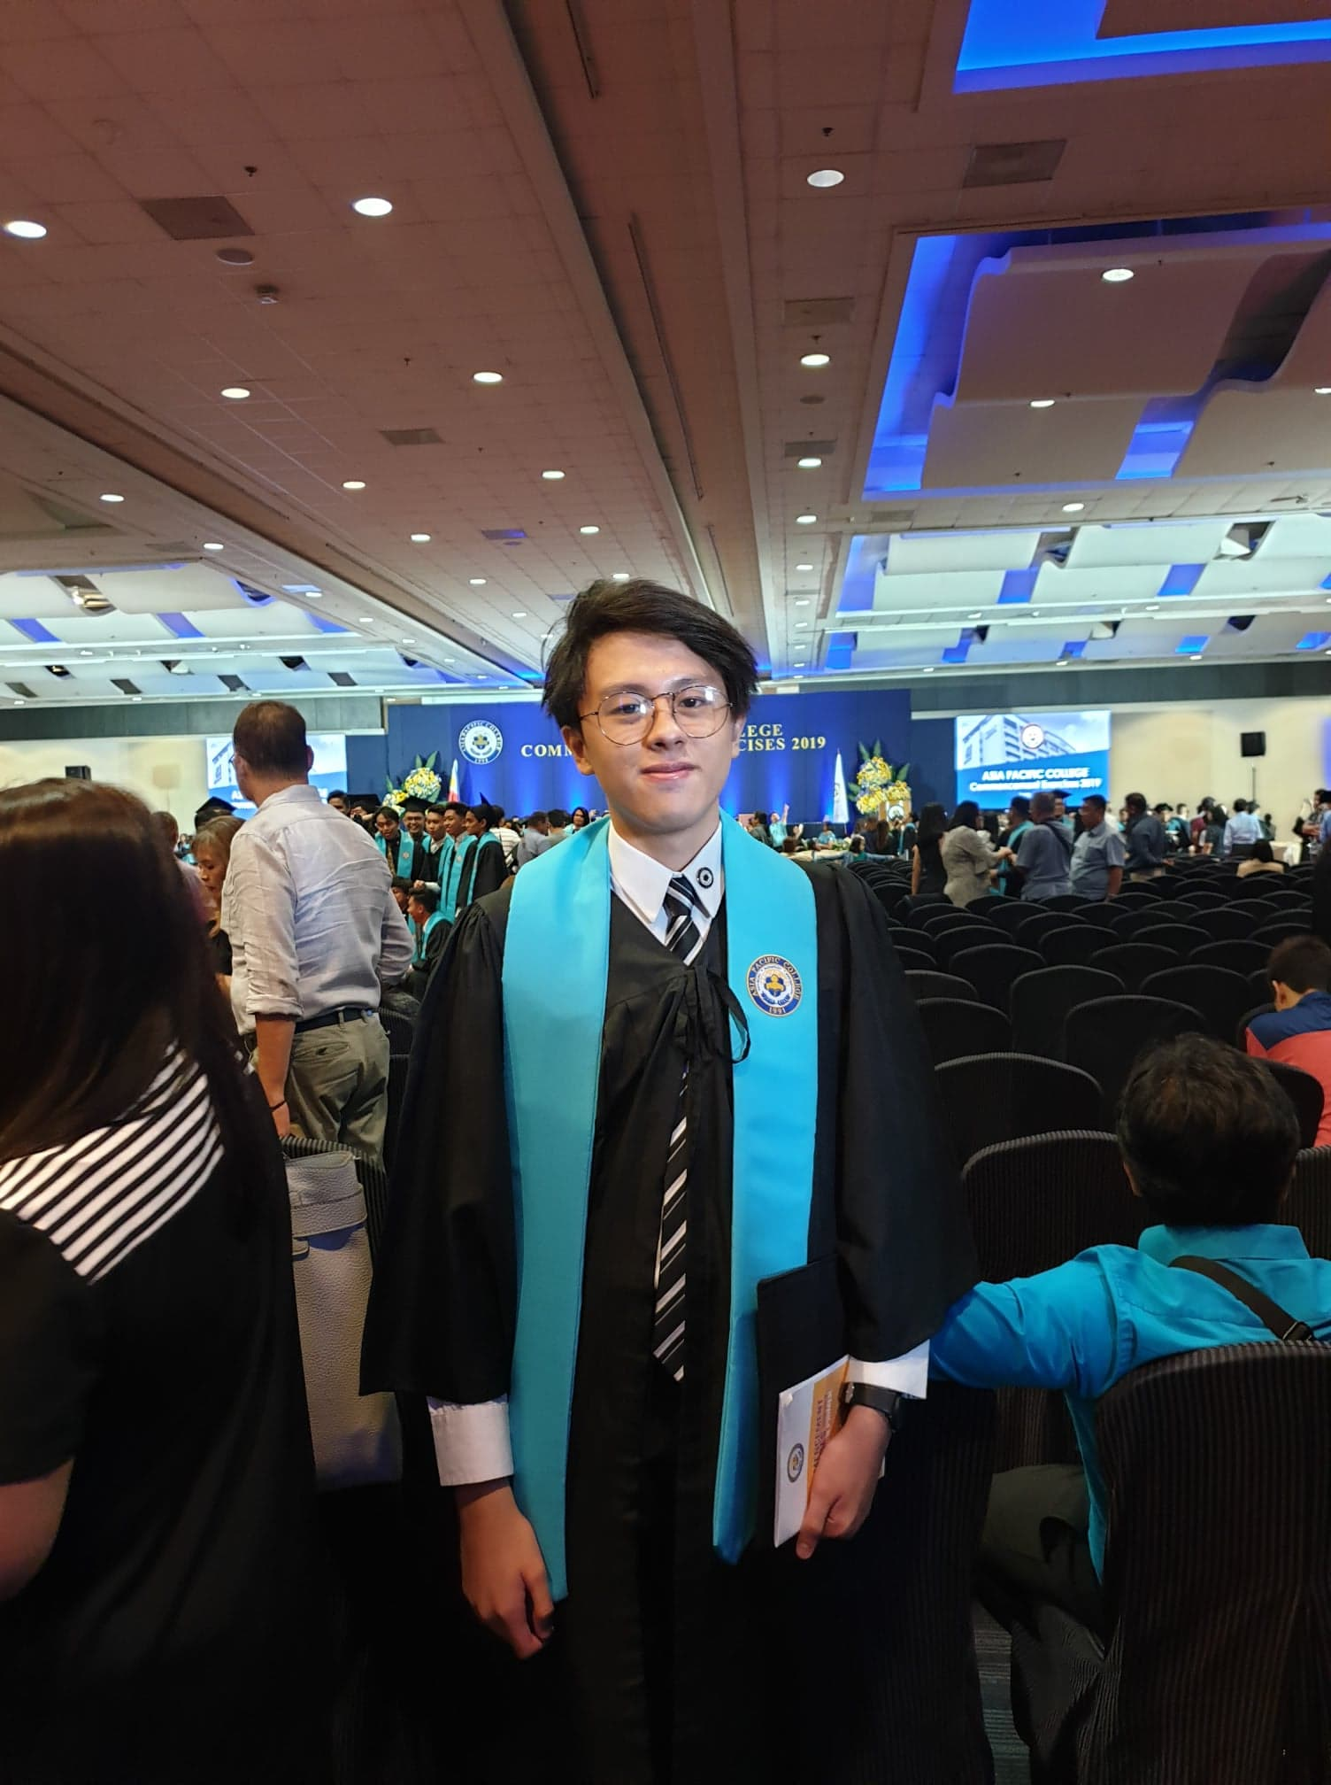
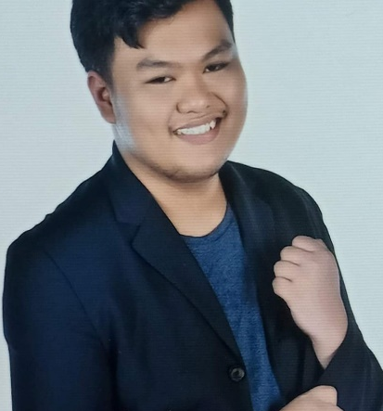
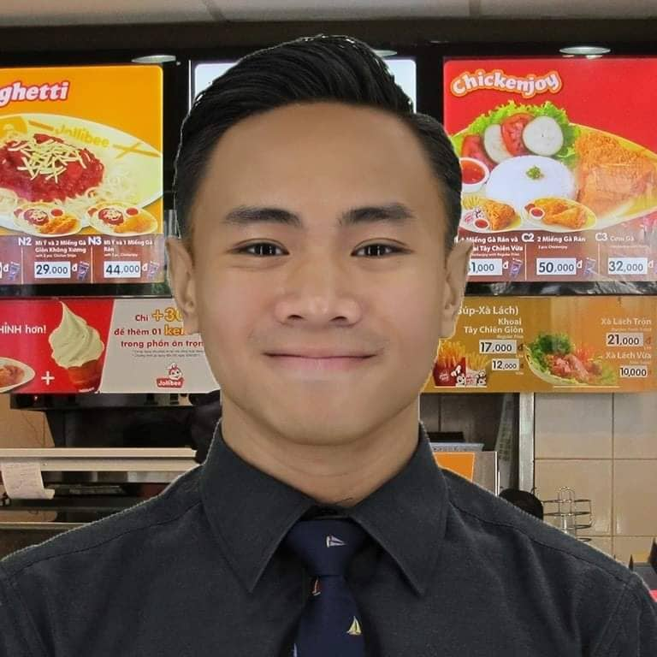
PROJMAN - Defense
OPTIMUMFIVE
Langcauon, John Christopher
Marc, Zamora
Aloya, Jayson
Sajul, Marc Julian
Prion, Jan Gabriel
Documentation
Head of Programming
Programmer: Back End
Project Leader/Scrum Master
External Communication
Head of Documentation
Product Owner
Programmer: Front End
Documentation

Slide 3
Information Technology Resource Office (ITRO)
Speaker: Jayson Aloya

Slide 4
RAM-IT: ITRO’s ChatBot &
Ticketing System
Speaker: Marc Zamora

Slide 5
Problem Statements
APC needs a system that enables ITRO to efficiently provide support and information to the APC Community.
1.) ITRO personnel are unable to provide support for online inquiries and concerns in a time efficient manner due to their demanding workload.
2.) ITRO personnel are unable to delegate, organize, and track the progress of online inquiries and concerns.
3.) ITRO personnel are unable to track the priority level of a concern which leads to them answering frequently asked problems one-by-one before answering specific inquiries that require more attention.
Speaker: John Christopher Langcauon

Slide 6
Purpose of the Project
To develop a system that enables ITRO to:
1.) efficiently provide customer support to the APC Community.
2.) provide online – using internet – customer support at any time of the day.
3.) centralize online – using internet – inquiries and concerns in one singular place for easy delegation, organizing, and tracking of progress.
Speaker: Marc Julian Sajul

Slide 7
Purpose of the Project
To develop a system that enables ITRO to:
4.) answer frequently asked problems in place of ITRO which enables ITRO to focus on inquiries or concerns that is much more necessary for them to answer manually.
5.) assign the priority level of inquiries or concerns, so they can tackle inquiries based on the level of priority.
Speaker: Marc Julian Sajul

Slide 8
Stakeholder Register
Name | Position | Internal, External | Project Role | Contact Information
Jojo Castillo | Head of ITRO | Internal | Project Sponsor | jojoc@apc.edu.ph
Jayson Aloya | Team Member | Internal | Project Manager | jqaloya@student.apc.edu.ph
Marc Julian Sajul | Team Member | Internal | Front-End Developer | mdsajul@student.apc.edu.ph
Marc Zamora | Team Member | Internal | Back-End Developer | mezamora@student.apc.edu.ph
John Christopher Langcauon | Team Member | Internal | Documentation Specialist | jtlangcauon@student.apc.edu.ph
Jan Gabriel Prion | Team Member | Internal | Documentation Specialist | jbprion@student.apc.edu.ph
Speaker: Jan Gabriel Prion

Slide 9
WBS
Speaker: Jayson Aloya

Slide 10
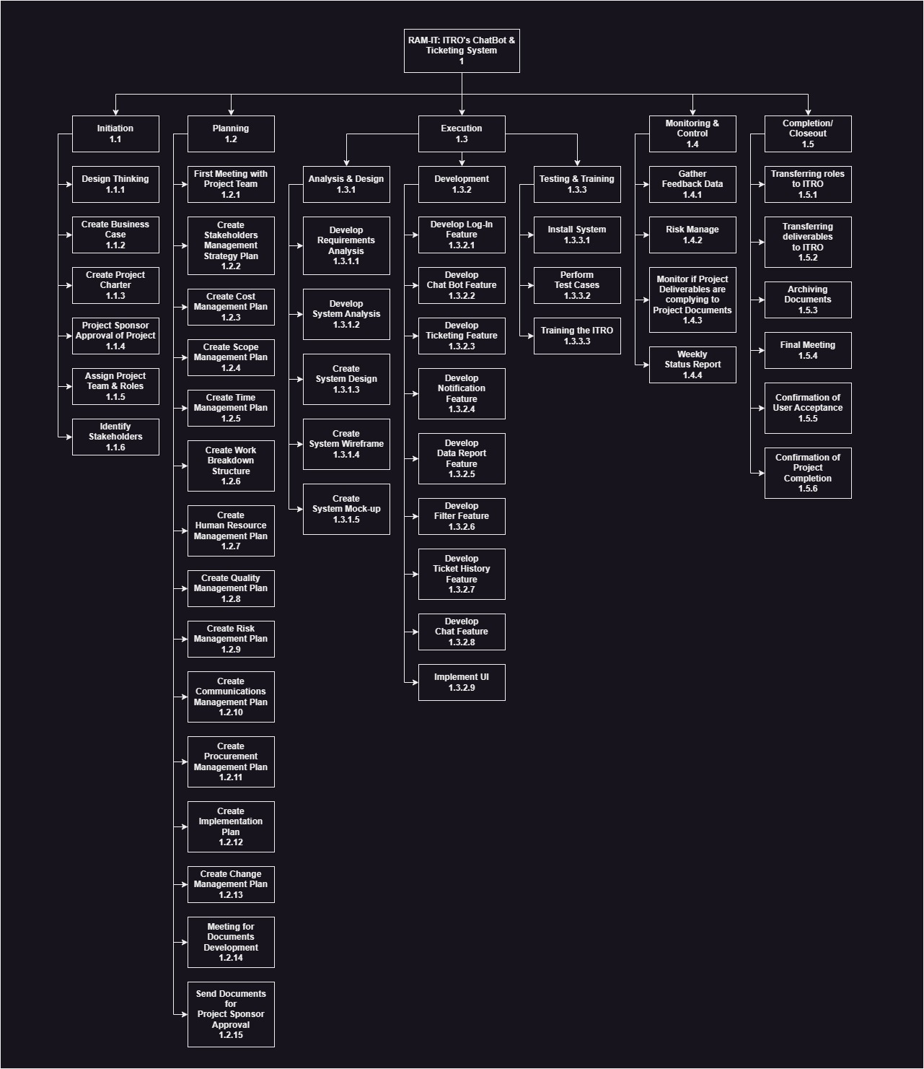
Speaker: Jayson Aloya

Slide 11
Project Cost Summary
Speaker: John Christopher Langcauon

Slide 12
Project Cost Summary
Approved Budget | ₱ 1,500,000.00
Manpower costs | ₱ 661,294.84
Contingency Cost | ₱ 66,129.484
Total Project Cost | ₱ 727,424.324
Speaker: John Christopher Langcauon

Slide 13
Schedule Gantt Chart Summary
Speaker: Marc Julian Sajul

Slide 14
PHASE | DURATION
Initiation | 03/23/2023 – 04/05/2023
Planning | 05/18/2023 – 09/01/2023
Execution | 09/04/2023 – 04/24/2024
Monitoring & Controlling | 09/04/2023 – 04/24/2024
Completion/Closeout | 04/24/2024 – 05/01/2024
Speaker: Marc Julian Sajul

Slide 15
Change Control Board
Speaker: Marc Zamora

Slide 16
Change Control Board Role | Role | Name | Contact | Responsibilities
Change Control Board Chair | Project Sponsor | Mr. Jojo F. Castillo | jojoc@apc.edu.ph | Accept or reject low/high modifications. Oversees the examining low effect adjustments and has the authority to override project manager decisions about change requests.
Change Control Board Member | Project Adviser | Ms. Jo Anne M. de la Cuesta | joannec@apc.edu.ph | Can establish if the change request will have a high or low impact. Ability to accept or reject low-impact adjustments. May in charge of creating an implementation strategy for the modification request, should it be granted. conveys the steps necessary to put the changes into effect. May update the project timeline, budget, and plan.
Change Control Board Member | Project Manager | Jayson Aloya | jqaloya@student.apc.edu.ph | In charge of accurately updating the change logs. Assures correct application of the Change Management methodology.
Speaker: Marc Zamora

Slide 17
Communication Matrix
Speaker: Jayson Aloya

Slide 18
Channel | From | To | Type | Frequency | Format Used | Delivery media
Document Development Meeting | Project Team | Project Manager | Meeting | Every Monday during the Planning Phase | Informal | Microsoft Teams
Progress Report | Project Manager, Project Team | Stakeholders | Meeting | Every Wednesday during the Execution Phase (Development Sub-phase) | Formal | Microsoft Teams
Status Report | Project Manager, Project Team | Stakeholders | Meeting | Every Wednesday during the Execution Phase (Testing & Training Sub-phase) | Formal | Microsoft Teams
Deliverables | Project Manager | Stakeholders | Artifact | Once a week | Written Document | Outlook
Speaker: Jayson Aloya

Slide 19
Risk Register
Speaker: Jan Gabriel Prion

Slide 20
Risk ID | Risk | Description | Category | Destination | Probability | Impact | Status
RID 001 | Scope Creep | There is a risk that the scope of the project may expand, leading to delays and cost overruns. | Project | Development Team | Medium (3) | Medium (3) | In progress
RID 002 | Technical Challenges | Technical challenges when developing a complex system that requires expertise, innovative problem-solving, and effective decision-making. | Technical | Development Team | Medium (3) | Medium (3) | In progress
RID 003 | Lack of project management and planning | Insufficient project management and planning can lead to chaotic workflows, missed deadlines, and project failure. | Project | Project Manager | Medium (3) | High (4) | In progress
Speaker: Jan Gabriel Prion

Slide 21
Transition Approach
Speaker: Marc Julian Sajul

Slide 22
PROJMAN - Defense
OPTIMUMFIVE
Langcauon, John Christopher
Marc, Zamora
Aloya, Jayson
Sajul, Marc Julian
Prion, Jan Gabriel
Documentation
Head of Programming
Programmer: Back End
Project Leader/Scrum Master
External Communication
Head of Documentation
Product Owner
Programmer: Front End
Documentation

